Slide 1
LESSON 17:
Raising Lazarus
The Life Of Christ – Perea to Bethany
John 11:1-57
January 12, 2021

Slide 2
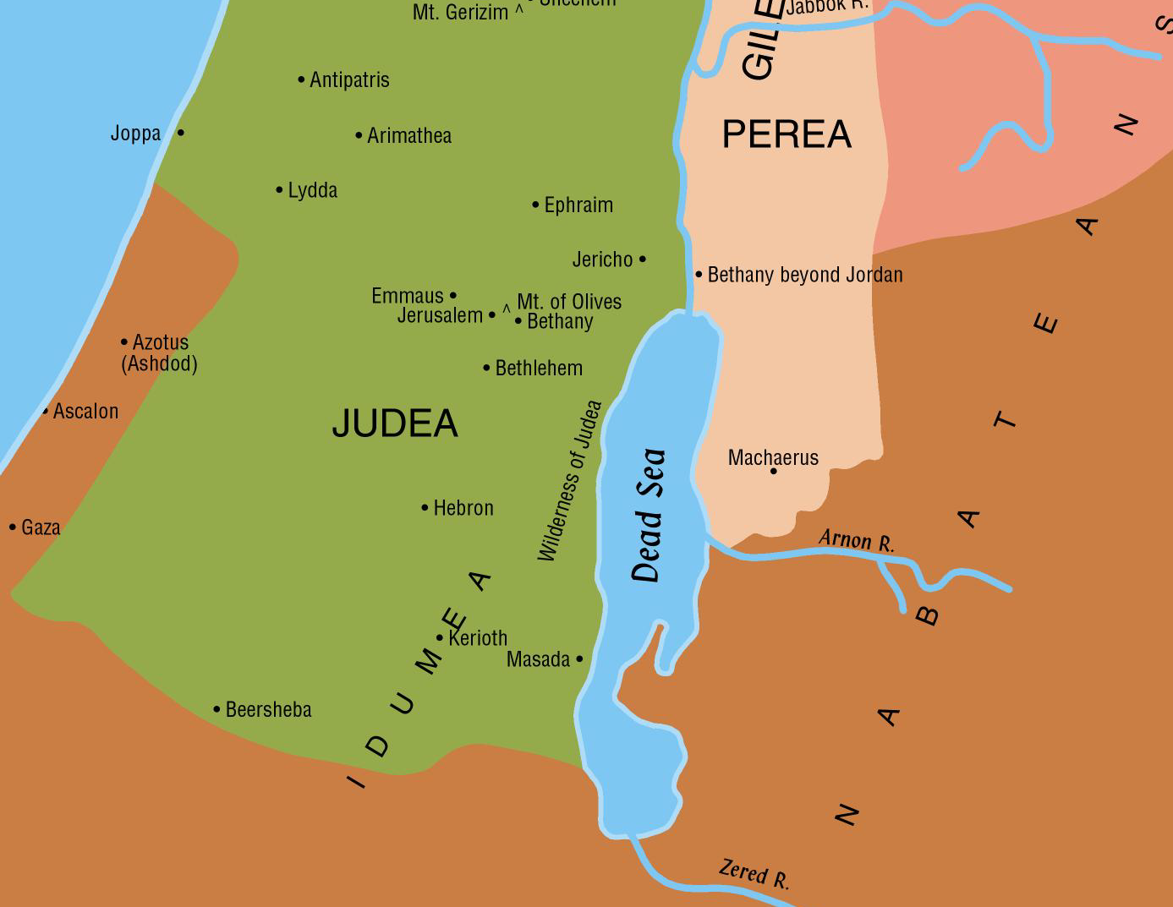
The High Priest Unwittingly Makes A True Prophecy. John 11:49-57
John 11:54, “Jesus therefore walked no more openly among the Jews, but departed thence into the country near to the wilderness, into a city called Ephraim; and there he tarried with the disciples.”
Jesus walked no more among the Jews in a public way. Rather He retired to a place called Ephraim about 20 miles from Jerusalem.

Slide 3
The High Priest Unwittingly Makes A True Prophecy. John 11:49-57
John 11:55, “Now the passover of the Jews was at hand: and many went up to Jerusalem out of the country before the passover, to purify themselves”
The phrase, “the Passover of the Jews was near,” appears also in John 2:13 and John 6:4.
“Its being called the Jews’ Passover shows that John wrote this gospel among people who were not Jews, and to whom it was necessary, therefore, to explain their customs.” (Barnes’ Notes)

Slide 4
The High Priest Unwittingly Makes A True Prophecy. John 11:49-57
If any were defiled in any manner by contact with the dead or by any other ceremonial uncleanness, they were required to take the prescribed measures for purification. (Leviticus 22:1-6)
Technically, there was no requirement in the Law that one wash before the feast, but uncleanness did exclude an individual from participation (John 18:28; compare Leviticus 7:21 and 2 Chronicles 30:17-18).

Slide 5
The High Priest Unwittingly Makes A True Prophecy. John 11:49-57
This cleansing was especially necessary, for those who traveled a great distance to the feast
(cf. Numbers 9:6-12; see also, Paul’s private vow in Acts 21:21-24).
Because of the large numbers of people involved taking their turn at the limited facilities of the city, Josephus informs us that pilgrims arrived in Jerusalem a week prior to the feast to accomplish these ablutions and assure full compliance with the Law (Jewish Wars 1.229; 6.290).

Slide 6
The High Priest Unwittingly Makes A True Prophecy. John 11:49-57
John 11:56-57, “They sought therefore for Jesus, and spake one with another, as they stood in the temple, What think ye? That he will not come to the feast? Now the chief priests and the Pharisees had given commandment, that, if any man knew where he was, he should show it, that they might take him.”
When the multitudes began to gather for the feast of the Passover, they began to inquire about Jesus. Would He come to the feast? If so, they would take Him.
  On the one hand, it was required by law that all males should come.
  On the other, His coming was attended with great danger.

Slide 7
The High Priest Unwittingly Makes A True Prophecy. John 11:49-57
John 11:56-57 – Their plan is definite. If any knew where Jesus was, they were to “show it, that they might take Him.”
Previously (John 2:13-25), He had attended the national festivals during which time He publicly taught in the temple area.
Would He continue this pattern of ministry? Large crowds gathering in the city kept looking for Him.
The religious authorities gave orders for anyone to report if he found out where Jesus was so they could arrest Him.

Slide 8
LESSON 17:
The Life Of Christ – Ten Lepers Healed and Concerning the Kingdom
Luke 17:11-37
January 12, 2021

Slide 9
Passing through Samaria and Galilee (Luke17:11)
Luke 17:11, “And it came to pass, as they were on the way to Jerusalem, that he was passing along the borders of Samaria and Galilee.”
Luke identified broad general geographical regions where Jesus was working. He sometimes did this to focus readers on the fact that Jesus was moving deliberately toward the consummation of His mission at Jerusalem (see Luke 9:51-53; 13:22, 33; 19:11, 28).

Slide 10
Passing through Samaria and Galilee (Luke17:11)
If our chronology is correct, Jesus passed northward from Ephraim about forty miles, crossing Samaria (here mentioned first), and coming to the border of Galilee. He then turned eastward along that border down the wadi Bethshean which separates the two provinces, and crossed the Jordan into Peræa, where we soon find Him moving on toward Jericho in the midst of the caravan of pilgrims on the way to the Passover.

Slide 11
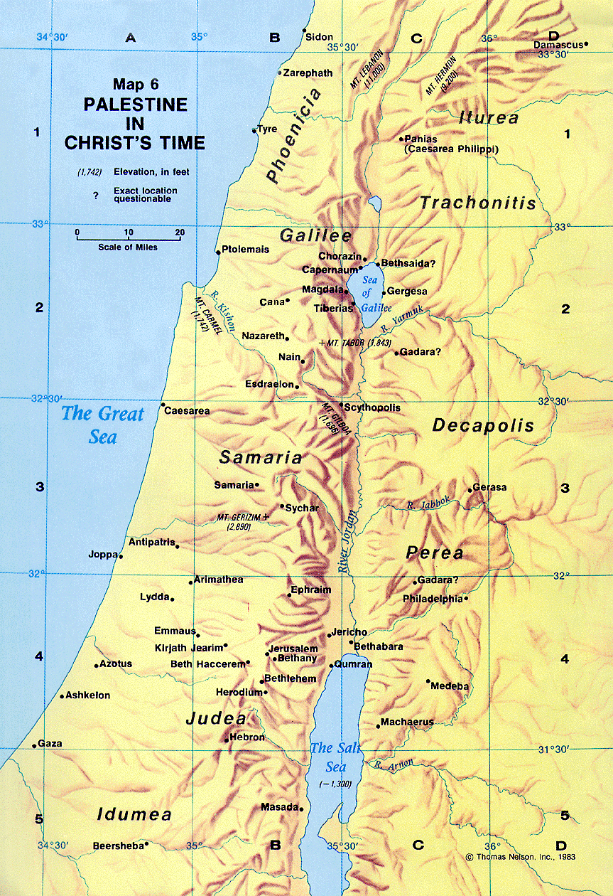
Passing through Samaria and Galilee (Luke17:11)

Slide 12
Passing through Samaria and Galilee (Luke17:11)
Luke 17:12-13, And as he entered into a certain village, there met him ten men that were lepers, who stood afar off: and they lifted up their voices, saying, Jesus, Master, Have mercy on us.”
Unnamed village.
Lepers stood afar off. (Numbers 15:2; see also
Leviticus 13).
“Master, Have mercy on us.”

Slide 13

Passing through Samaria and Galilee (Luke17:12-13)
Elisha’s day: Four lepers spoke to one another at the gate of Samaria and went out together to the camp of the Syrian army
(2 Kings 7:1-4).
See Luke 5:12-16 for further details on the leper’s physical condition.
These lepers were not allowed to be in close contact with Jesus or His disciples.

Slide 14
Passing through Samaria and Galilee (Luke17:12-13)
“Master, Have mercy on us.” Luke 17:13
Indicates prior knowledge.
After preaching the Sermon on the Mount, another leper had been cleansed by Jesus. Matthew 8:1-4
Note the appeals:
  Of blind Bartimaeus. Mark 10:47
  The two blind men. Matthew 9:27
  Two other blind men at Jericho. Matthew 20:30 - 31
  The woman of Canaan. Matthew 15:22
  The father of an epileptic son. Matthew 17:15
  And the rich man in torment. Luke 16:24

Slide 15
Passing through Samaria and Galilee (Luke17:11)
Luke 17:14, “And when he saw them, he said unto them, Go and show yourselves unto the priests. And it came to pass, as they went, they were cleansed.”
Show yourselves to the priests. Leviticus 13:2; 14:2;
cf. Luke 5:14
Note:
  We do not know if they hesitated but we do know that they all went.
  We do not know if Jesus touched them as He had done with other lepers. (Luke 5:12- 13)
  We do not know how much time transpired or how far they walked before they discovered that they were healed.

Slide 16
Naaman The Leper
2 Kings 5:1-14

